Slide 1
National Database of Child Care Prices Analysis
By: Taylor Duncan
Notes:
Today we’ll be discussing childcare cost disparities in the United States from 2008 to 2018, using data from the National Database of Child Care Prices. This work highlights cost trends, geographic inequalities, and potential socioeconomic impacts, particularly for working families.

Slide 2
Introduction & Objectives
Overview of the dataset: 2008-2018 county-level childcare cost data from the U.S. Department of Labor
Objectives: Identify trends, regional disparities, and socio-economic impacts of childcare costs
Notes:
My goal was to identify national trends, pinpoint regions with significant disparities, and explore how rising childcare costs affect female labor force participation. The ultimate objective is to equip policymakers with data-driven insights for improving childcare affordability.

Slide 3
Dataset & Key Variables
Data source: National Database of Child Care Prices
Key variables: UNR_16, FUNR_16, MUNR_16 (center-based and family-based costs)
Supporting data: Female labor force participation metrics
Notes:
County-level cost data was used for various childcare types, including UNR_16 for center-based care and FUNR_16 for family-based care. I also integrated female labor force participation metrics, giving us both economic and social context.

Slide 4
Data Preparation & Assumptions
Steps: Validation, missing value handling, type checks
Assumptions: Monetary fields as per-child averages; zero values as missing; FIPS codes as unique IDs
Inflation adjustments not confirmed
Notes:
I validated the dataset, addressed missing values, and confirmed data types. I assumed cost values represented per-child averages, treated zeros as missing data, and used FIPS codes for accurate geographic mapping. Inflation adjustments were not confirmed, which we note as a limitation.

Slide 5
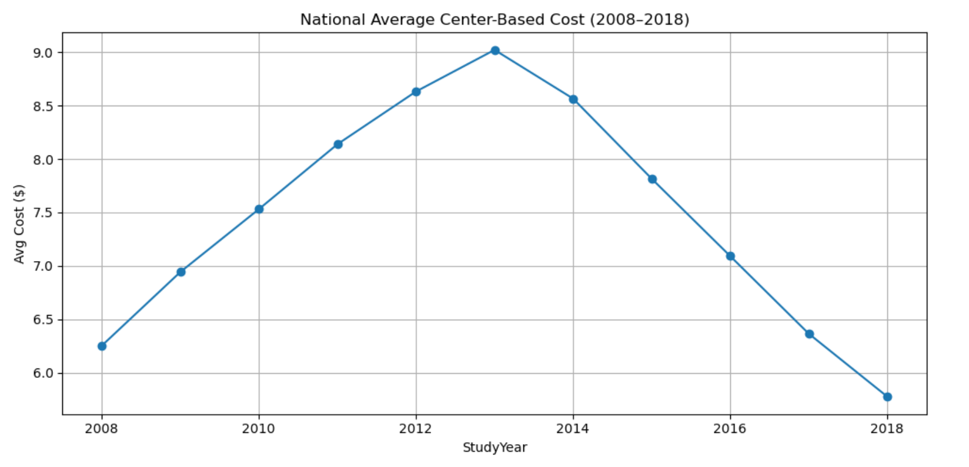
National Cost Trends (2008-2018)
Line chart: Average national cost per day (UNR_16)
Highlight steady increase over 11 years
National average: ~$7.47/day, peak values up to $36
Notes:
This line chart shows a steady national rise in daily childcare costs from 2008 to 2018. The national average reached $7.47 per day, with peaks as high as $36, signaling growing financial strain for many families.

Slide 6
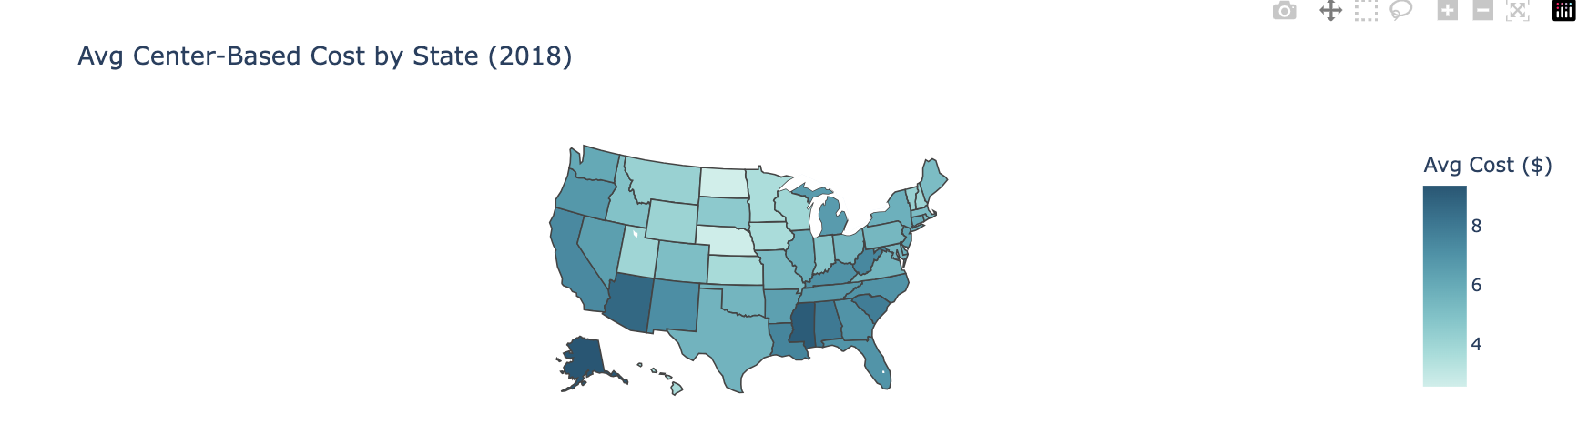
Geographic Disparities
Choropleth map: State-level cost variations
Northeast & West: higher costs
South & Midwest: lower averages
Notes:
The choropleth map reveals that northeastern and western states generally have the highest childcare costs, while the South and Midwest report lower averages. This uneven distribution highlights significant regional inequities.

Slide 7
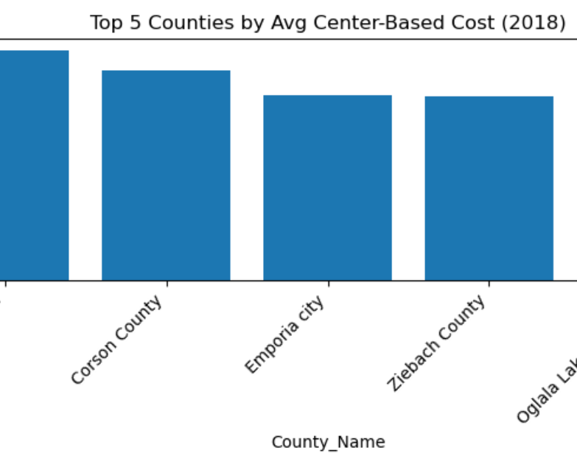
Cost Growth Hotspots
Top 5 most expensive counties (2018)
Fastest-growing counties (2015-2018)
Bar chart comparison
Notes:
This bar chart highlights both the most expensive counties in 2018 and the counties with the fastest cost growth between 2015 and 2018. Rapid increases are not limited to historically high-cost areas, suggesting emerging affordability challenges.

Slide 8
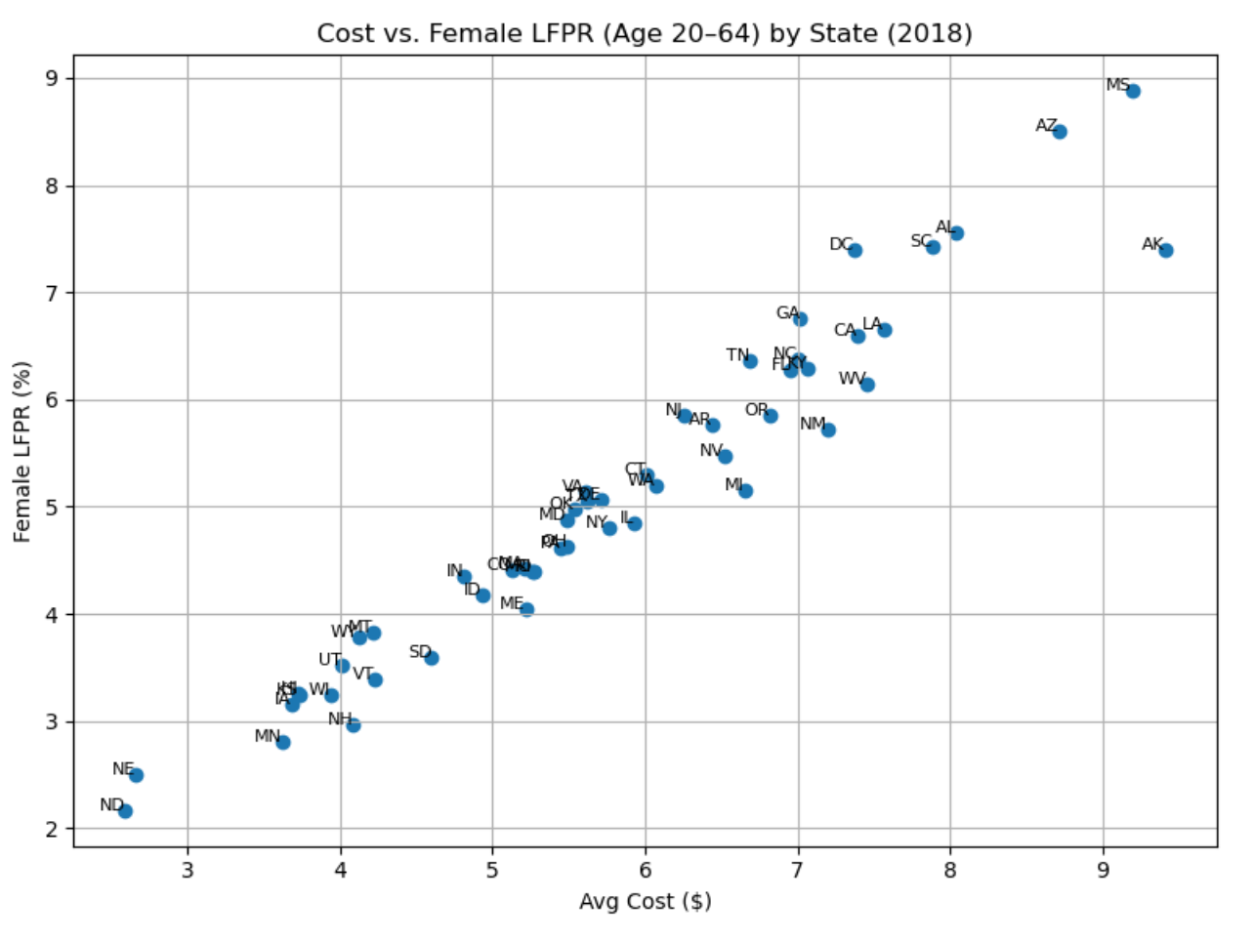
Socioeconomic Impact
Scatterplot: UNR_16 vs. Female labor force participation (FUNR_20to64)
Observation: Higher childcare costs often correlate with slightly lower female participation rates
Notes:
This scatterplot compares childcare costs with female labor force participation. The slight negative correlation suggests that higher childcare costs may be linked to lower female workforce participation, raising concerns about accessibility.

Slide 9
Key Insights
Costs rising nationwide, but unevenly
Significant regional disparities
Potential barrier to female workforce participation
Notes:
Childcare costs are rising nationwide but not evenly, creating pockets of severe financial pressure. These disparities can limit women’s workforce participation and deepen socioeconomic divides.

Slide 10
Policy Recommendations
Subsidies for high-cost regions
Inflation-indexed cost monitoring
Improved provider regulation
Notes:
To address these challenges, it’s recommended to targeted subsidies in high-cost regions, inflation-indexed cost tracking, and stronger regulation of childcare providers to ensure affordability and quality.

Slide 11
Ethical Considerations & Limitations
Transparency in data cleaning & transformations
Risk of overgeneralization when aggregating
Need for demographic overlays for deeper context
Notes:
I prioritized transparency in all transformations and were careful not to misrepresent the data. Risks remain—such as overgeneralization when aggregating—and there seems to be a need for integrating demographic overlays for deeper context.

Slide 12
Conclusion & Next Steps
Summary of findings
Future plans: Inflation adjustment, demographic integration, multivariate modeling
Closing remark: Data-driven strategies for equitable childcare access
Notes:
In summary, childcare costs are climbing and unevenly distributed, with real impacts on families and the workforce. Our next steps include confirming inflation adjustments, adding demographic analysis, and exploring advanced modeling to strengthen policy recommendations.

